Slide 1

TAK Computers Inventory Management Website
Thomson Ly
Aleksandar Milosevski
Kellen Leclair

Slide 2
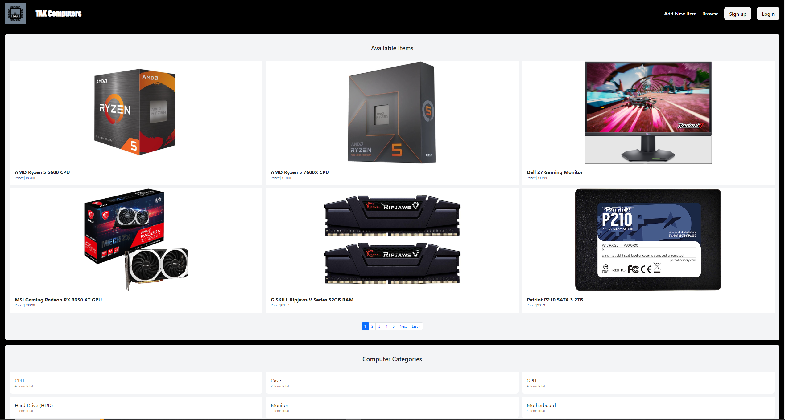
Sample Screenshot of our Front Page

Slide 3
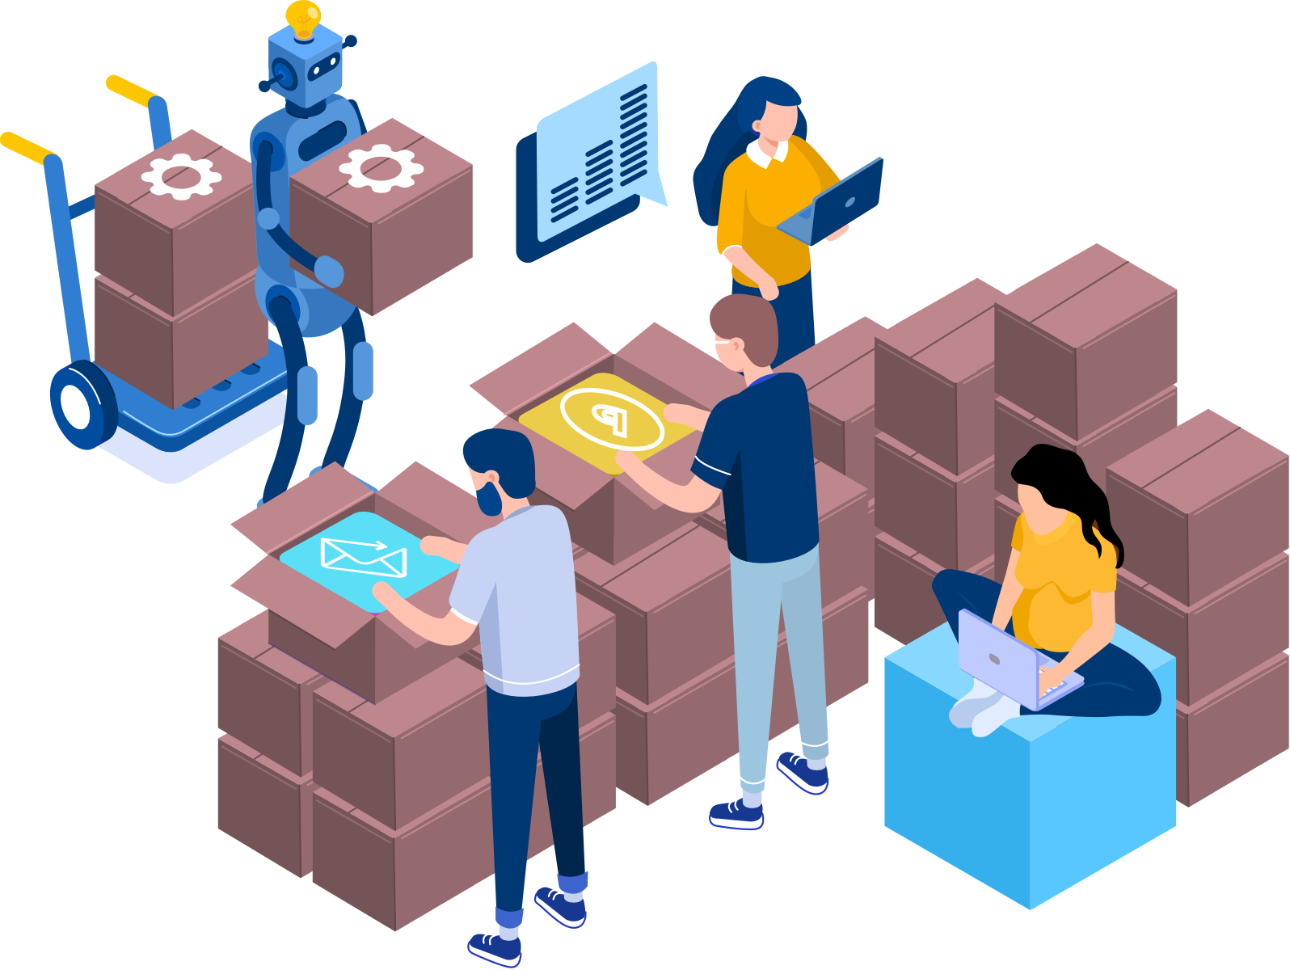
Programming Languages & Technologies
Backend: Used Django, a high level open-source web framework written in Python, for building web applications
Frontend: HTML, BootStrap, and Tailwind CSS for styling (changing colours/fonts, adding pictures and formatting, adding menus, etc.)
Collaborated using Github

Slide 4

Demo Time!

Slide 5

Challenges
Learning Django (Python) framework
Setting up virtual development environment
Learning to use GIT/GitHub effectively as a group
Delegating work/tasks

Slide 6

Future Scopes/Work
Advanced search/filtering
Password Recovery
Shopping Cart
Online Hosted Website
Image Carousel/Gallery Format for Items
Responsive Design (Mobile + Other Devices)

Slide 7
Thank You!

